Slide 1
About Me

Slide 2
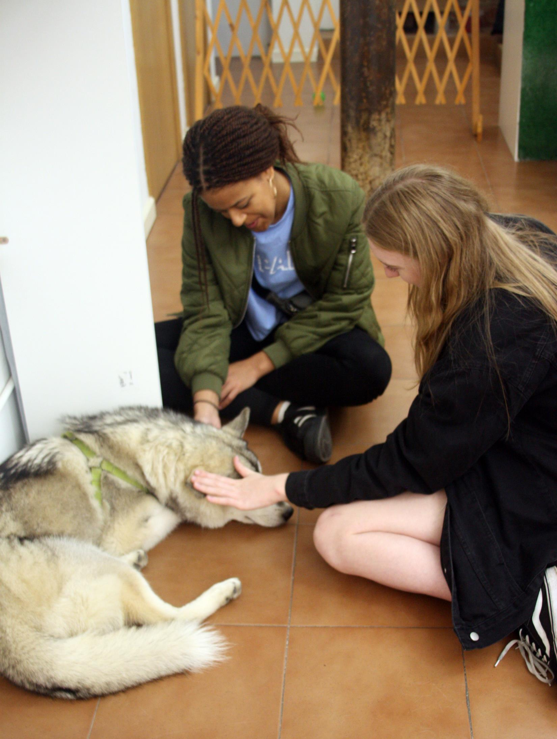
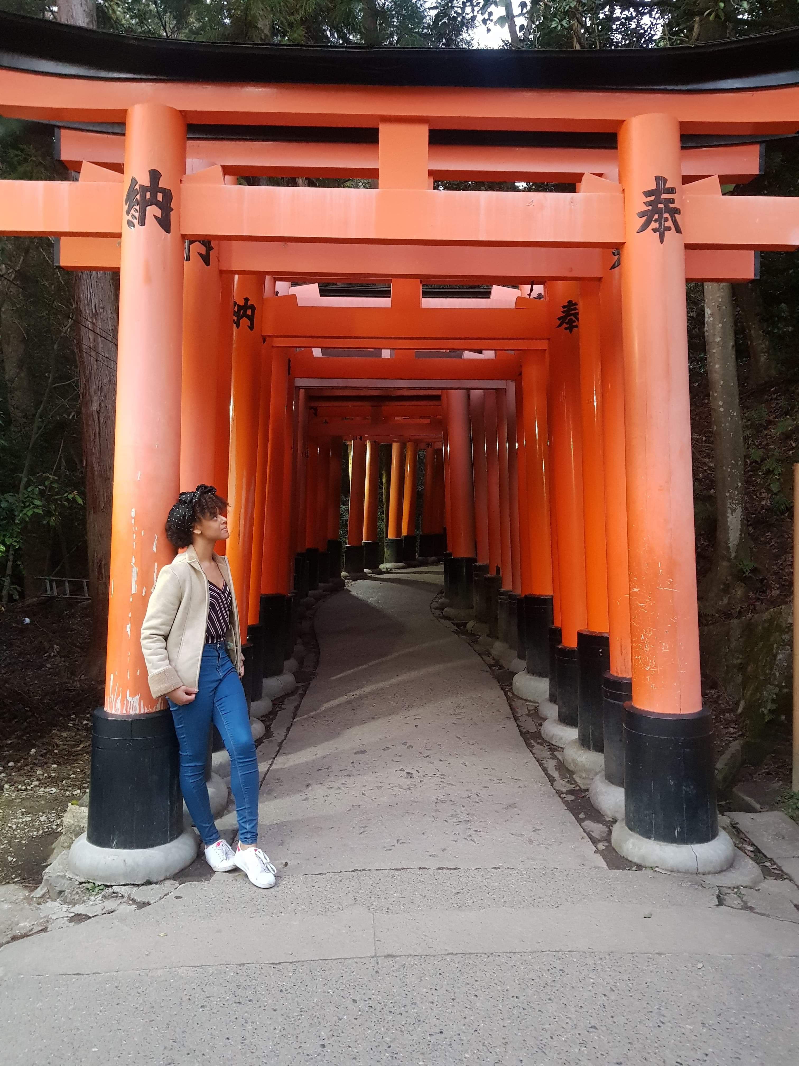
Two Truths, One Lie
  I have visited countries in Europe, Africa, Asia and America.
  I have more than 20 cousins.
  My family has three dogs.

Slide 3
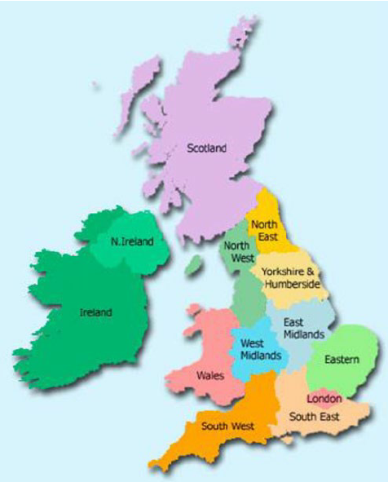
Where am I from?
I am from the United Kingdom (UK).
The UK has four parts – England, Scotland, Wales and Northern Ireland.
Where do you think I am from – England, Scotland, Wales or Northern Ireland?

Slide 4
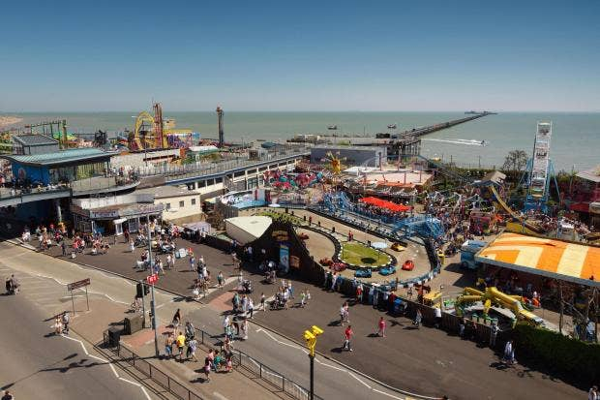
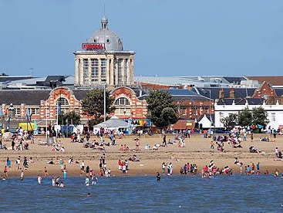
Where am I from?
Southend is in the east of England.
Southend is close to London, you can visit London on the train.
Many people visit Southend in the summer – look at the pictures, why do you think people visit Southend?

Slide 5
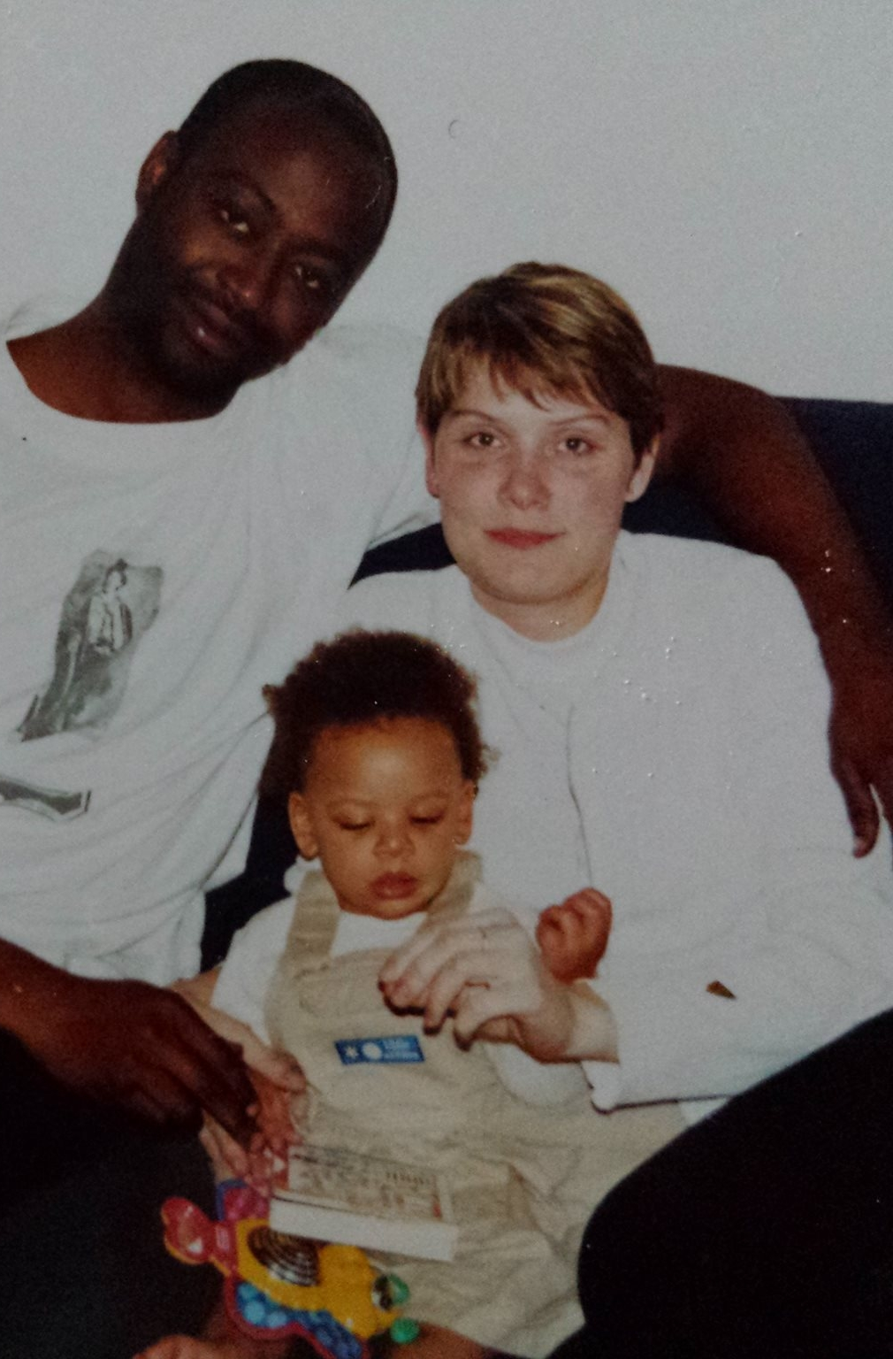
My Family
My mum’s name is Anita. My mum was a nurse, she worked in a hospital.
My mum has a small family. She has one sister and no cousins.
My dad’s name is Kevin. He also used to be a nurse.
My dad has a very big family. He has two brothers and many aunts and uncles.

Slide 6
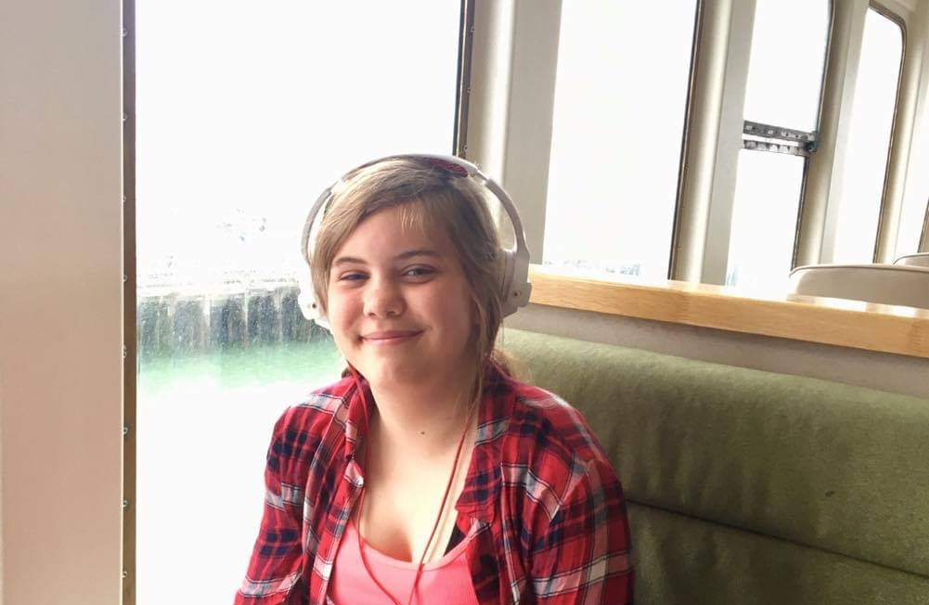
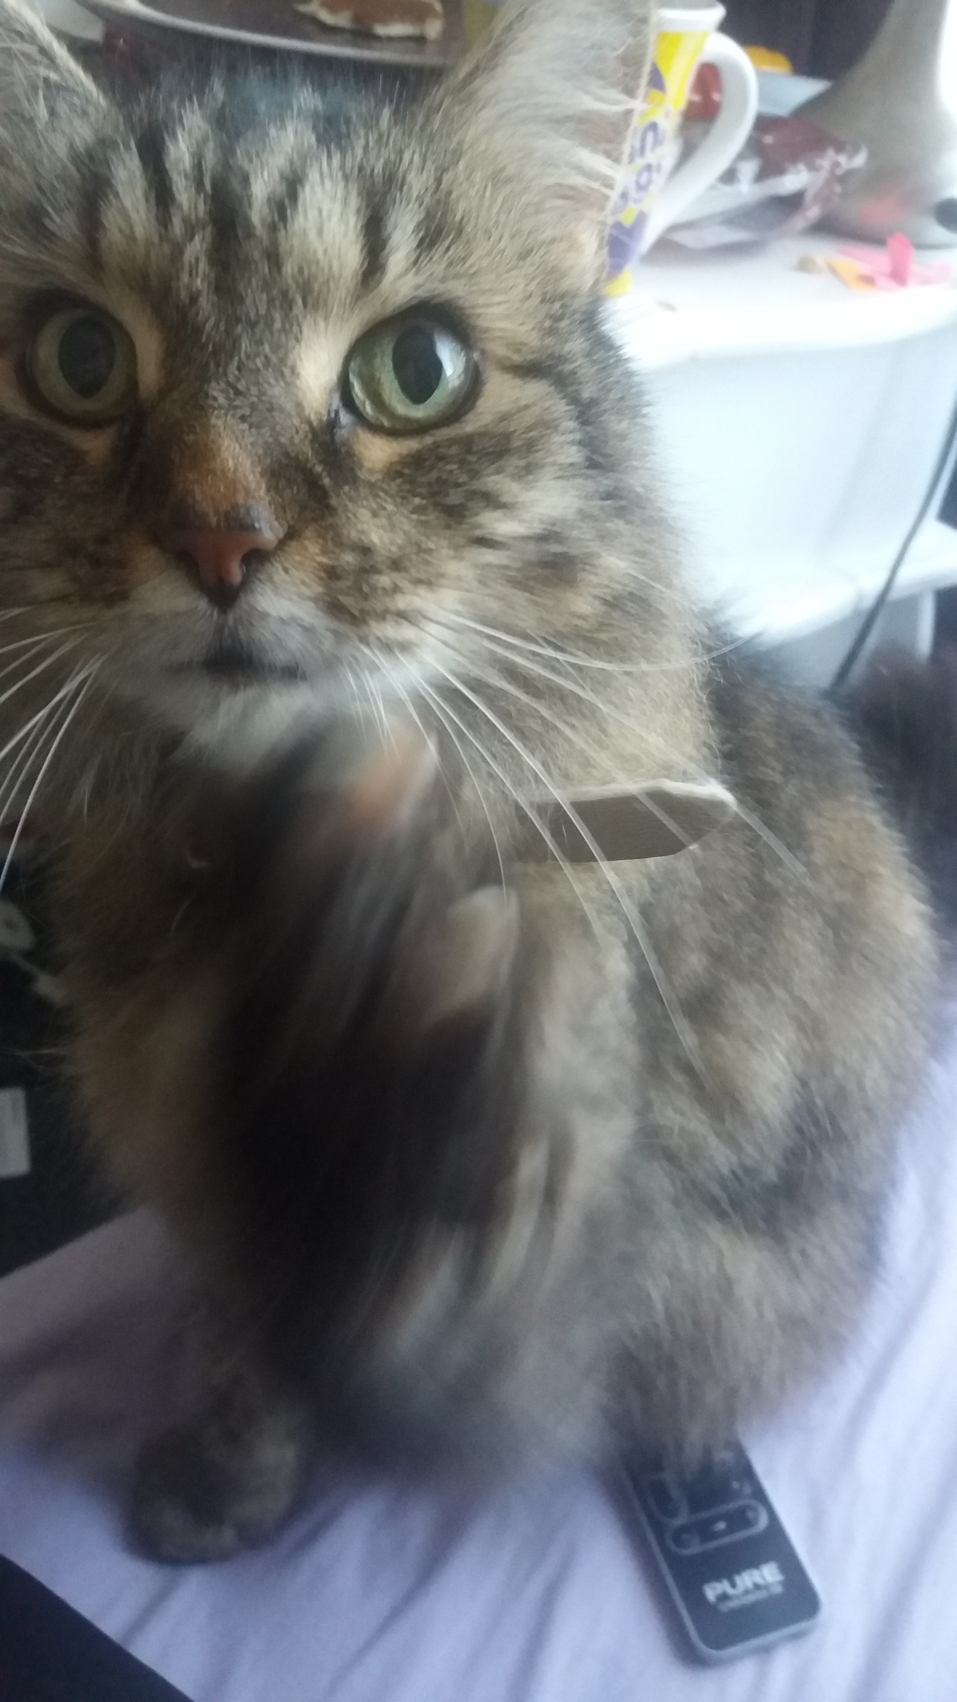
My Family
I have one sister. Her name is Alice and she is fifteen years old.
We have the same mum but different dads.
We also have a cat, her name is Gracie and she is eighteen years old.

